Slide 1
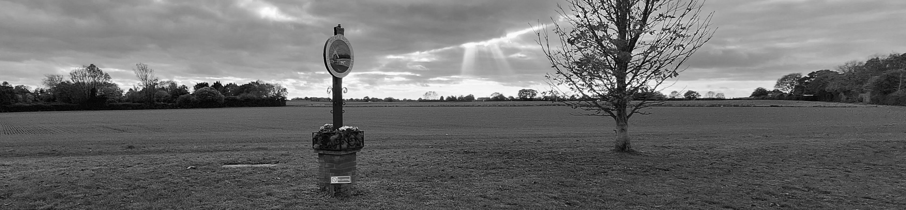
Wicklewood
Neighbourhood Plan

Slide 2
Aims today
What is a Neighbourhood Plan?
Do we want want one?

Slide 3
Background
Local authority housing targets set by Westminster
Local authorities decide how to meet their assigned targets
2024 Greater Norwich Local Plan (GNLP) aims to limit further spread:
  Existing towns and cities
  Key service centres
This policy is called the Village Clusters Housing Allocation Plan (VCHAP)

Slide 4
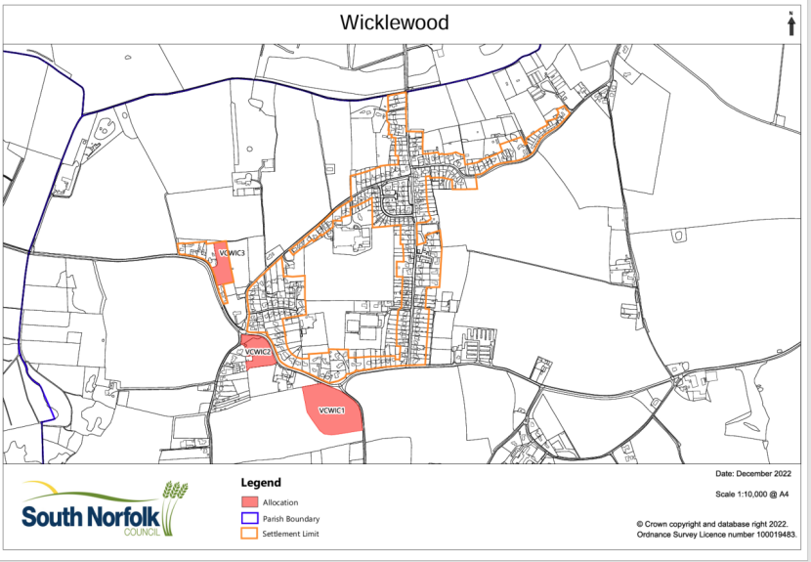
Norfolk 2025: 1200 homes
Wicklewood407 + 52 houses
WIC 1=40
Overturned by Inspector

Slide 5
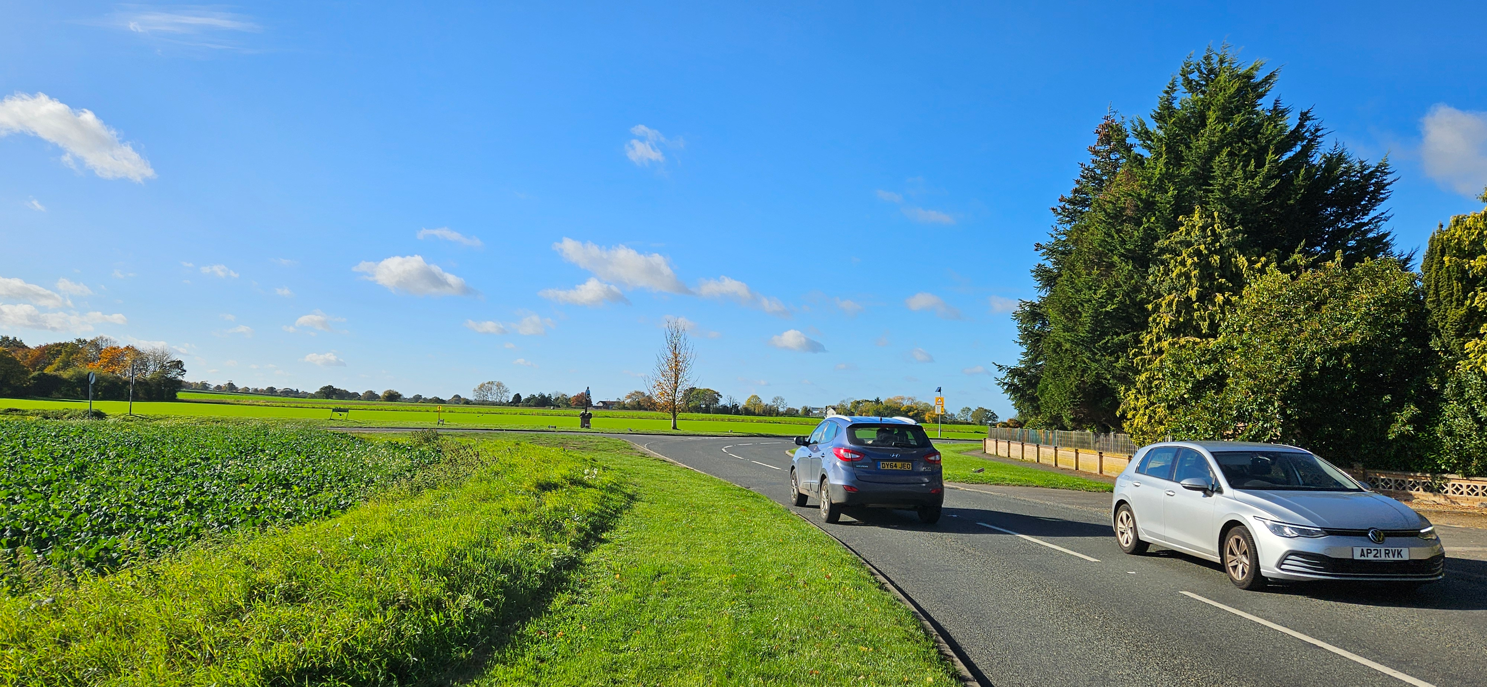
WIC 1

Slide 6
New housing targets
53% increase on 2025

Slide 7
Neighbourhood Plan purpose
Enable communities to have a say about the development and growth of their local area
An agreed Neighbourhood Plan must be taken into account when assessing planning applications for new development in that area
Planners do not have stick to everything agreed in a Neighbourhood Plan
But they do have to present good reasons for deviations

Slide 8
The process
Form a steering group
Define the Neighbourhood Area (the area you want your plan to cover)
Gather evidence from the community on the key issues to be addressed within the plan
Prepare and consult on a draft Neighbourhood Plan
Submit the Neighbourhood Plan to the local authority
Independent examination of the Neighbourhood Plan
Community referendum on the Neighbourhood Plan
Adoption of the Neighbourhood Plan by the local authority

Slide 9
Neighbourhood Plan resources
Planning toolkits & templates:
https://www.gov.uk/government/publications/how-to-create-a-neighbourhood-plan
South Norfolk Council funding:
Up to £6,000 for early-stage neighbourhood plans
Up to £10,000 additional via the Council’s Transitional Fund
Other council’s plans

Slide 10


Questions?

Slide 11
Next steps
Join the steering group
Tell your neighbours and friends
Help find out what our residents want/don’t want

Slide 12
Share your contact details
Email: clerk@wicklewoodpc.norfolkparishes.gov.uk
Subject: Neighbourhood Plan
Your name
Your email address
Your mobile number

